Slide 1
Introduction to Deep Learning

Slide 2
What is Deep Learning?
Deep Learning is a computer software that mimics the network of neurons in a brain. It is a subset of machine learning based on artificial neural networks with representation learning. It is called deep learning because it makes use of deep neural networks. This learning can be supervised, semi-supervised or unsupervised.
Deep learning algorithms are constructed with connected layers.
The first layer is called the Input Layer
The last layer is called the Output Layer
All layers in between are called Hidden Layers. The word deep means the network join neurons in more than two layers.

Slide 3
What is Deep Learning?
Deep Learning (sometimes called Deep Structured Learning) is a type of machine learning algorithm based on Artificial Neural Network technology (ANN).
Deep learning and other ANN methods allow computers to learn by example in a similar way to the human brain. This is accomplished through passing input data through multiple levels of Neural Net processing to transform data and narrow the possible predictions each step along the way.

Slide 4
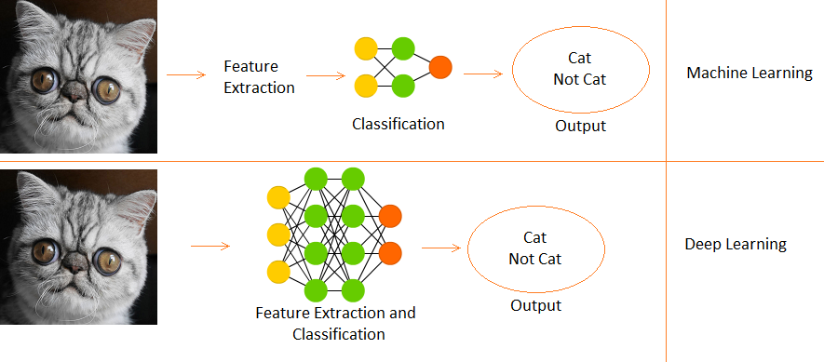
Difference Between Deep Learning and Machine Learning
Deep Learning is a subset of Machine Learning.
In Machine Learning features are provided manually.
Whereas Deep Learning learns features directly from the data.

Slide 5
How Does Deep Learning Work?
Deep Neural Networks have multiple layers of interconnected artificial neurons or nodes that are stacked together. Each of these nodes has a simple mathematical function—usually a linear function that performs extraction and mapping of information.
There are three layers to a deep neural network: the input layer, hidden layers, and the output layer.

Slide 6
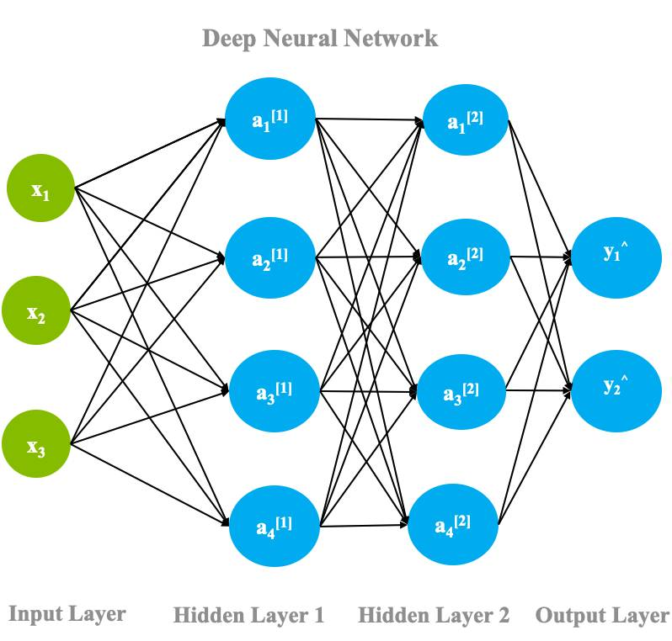
Deep neural network architecture

Slide 7
Deep neural network architecture
The data is fed into the input layer.
Each node in the input layer ingests the data and passes it onto the next layer, i.e., the hidden layers. These hidden layers increasingly extract features from the given input layer and transform it using the linear function.
These layers are called hidden layers because the parameters (weights and biases) in each node are unknown; these layers add random parameters to transform the data, each of which yields different output.
The output yielded from the hidden layers is then passed on to the final layer called the output layer, where depending upon the task, it classifies, predicts, or generates samples.
This process is called forward propagation.

Slide 8
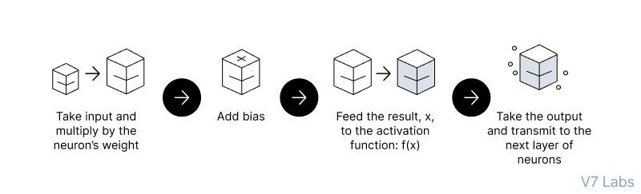
Forward propagation

Slide 9
Backpropagation
In another process called backpropagation, an algorithm, like gradient descent, calculates errors by taking the difference between the predicted output and the original output.
This error is then adjusted by fine-tuning the weights and biases of the function by moving backward through the layers.
Both, the process of forward propagation and backpropagation allows a neural network to reduce the error and achieve high accuracy in a particular task. With each iteration, the algorithm becomes gradually more accurate.

Slide 10
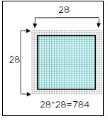
How Do Neural Networks Work?
the neural network will be trained to identify shapes. The shapes are images of 28*28 pixels.

Slide 11
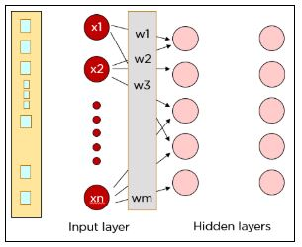
Each pixel is fed as input to the neurons in the first layer. Hidden layers improve the accuracy of the output. Data is passed on from layer to layer overweight channels. Each neuron in one layer is weighted to each of the neurons in the next layer.

Slide 12
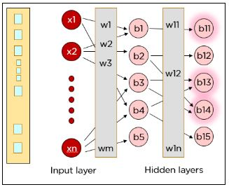
Each neuron in the first hidden layer takes a subset of the inputs and processes it. All the inputs are multiplied by their respective weights and a bias is added. The output of the weighted sum is applied to an activation function. The results of the activation function determine which neurons will be activated in the following layer.
Step 1: x1*w1 + x2*w2 + b1
Step 2: Φ(x1* w1 + x2*w2 + b1)
where Φ is an activation function

Slide 13
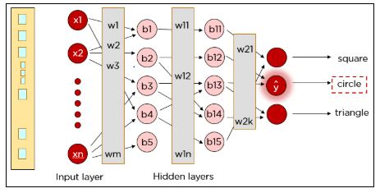
The above steps are performed again to ensure the information reaches the output layer, after which a single neuron in the output layer gets activated based on the activation function’s value
our actual input was a square, but the neural network predicted the output as a circle. So, what went wrong?
The neural network has to be trained until the predicted output is correct and the predicted output is compared to the actual output by calculating the cost function.

Slide 14
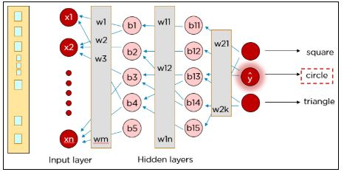
The cost function is calculated using the formula where Y is the actual value and Y hat is the predicted value. The cost function determines the error in the prediction and reports it back to the neural network. This is called backpropagation.
The weights are adjusted to reduce the error. The network is trained with the new weights.

Slide 15
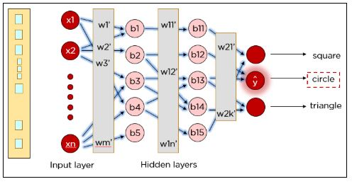
Once again, the cost is determined and the backpropagation procedure is continued until the cost cannot be reduced any further.

Slide 16
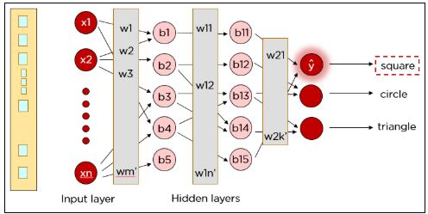
Similarly, our network can be trained to predict circles and triangles too.

Slide 17
Types of neural networks
CNN
Recurrent Neural Network
GAN
Restricted Boltzmann Machine
Autoencoders

Slide 18
CNN
The Convolutional Neural Networks or CNNs are primarily used for tasks related to computer vision or image processing.
CNNs are extremely good in modeling spatial data such as 2D or 3D images and videos. They can extract features and patterns within an image, enabling tasks such as image classification or object detection.

Slide 19
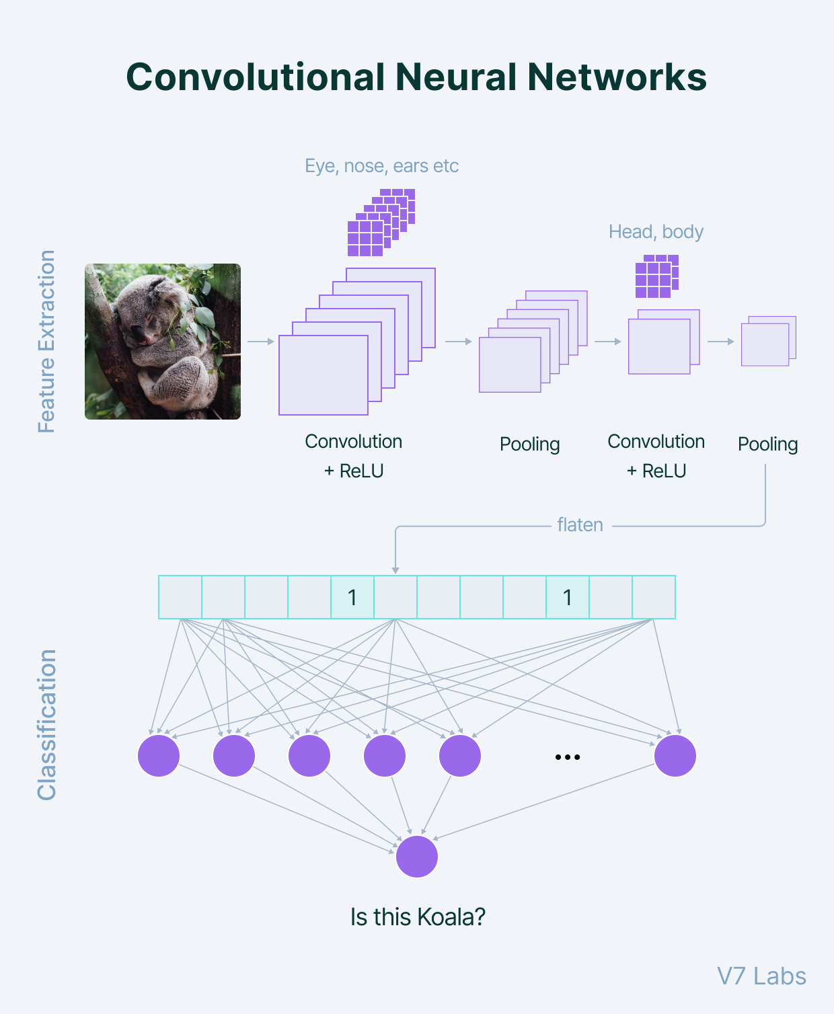

Slide 20
RNN
The Recurrent neural network mainly accesses the preceding info of existing iterations. For example, to guess the succeeding word in any sentence, one must have knowledge about the words that were previously used.
The Recurrent Neural Networks or RNN are primarily used to model sequential data, such as text, audio, or any type of data that represents sequence or time.
They are often used in tasks related to natural language processing (NLP).

Slide 21
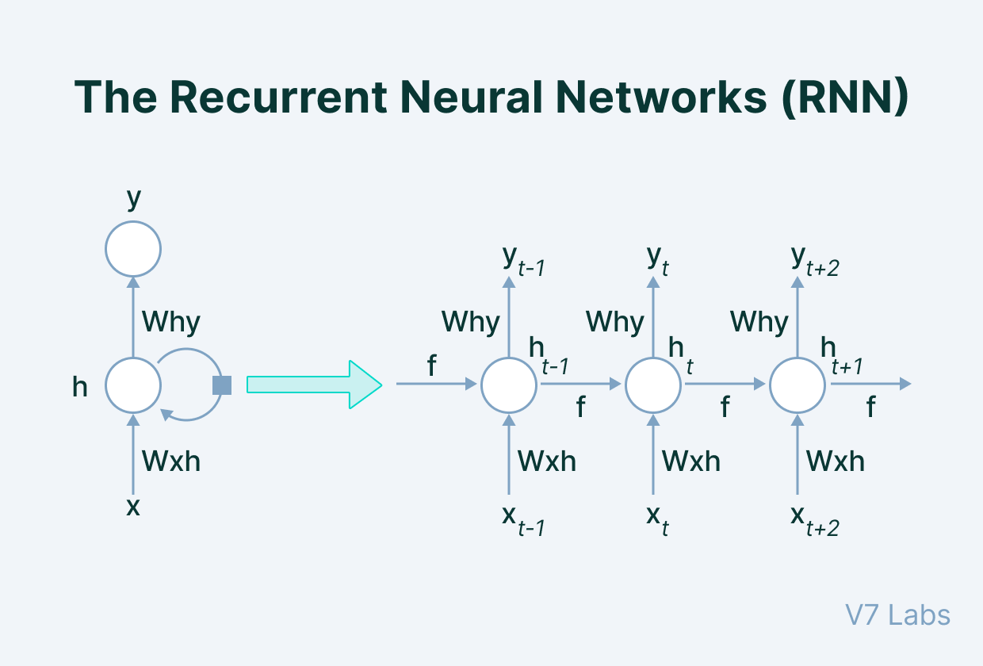

Slide 22
GAN
Generative adversarial networks or GANs are frameworks that are used for the tasks related to unsupervised learning.
This type of network essentially learns the structure of the data, and patterns in a way that it can be used to generate new examples, similar to that of the original dataset.

Slide 23
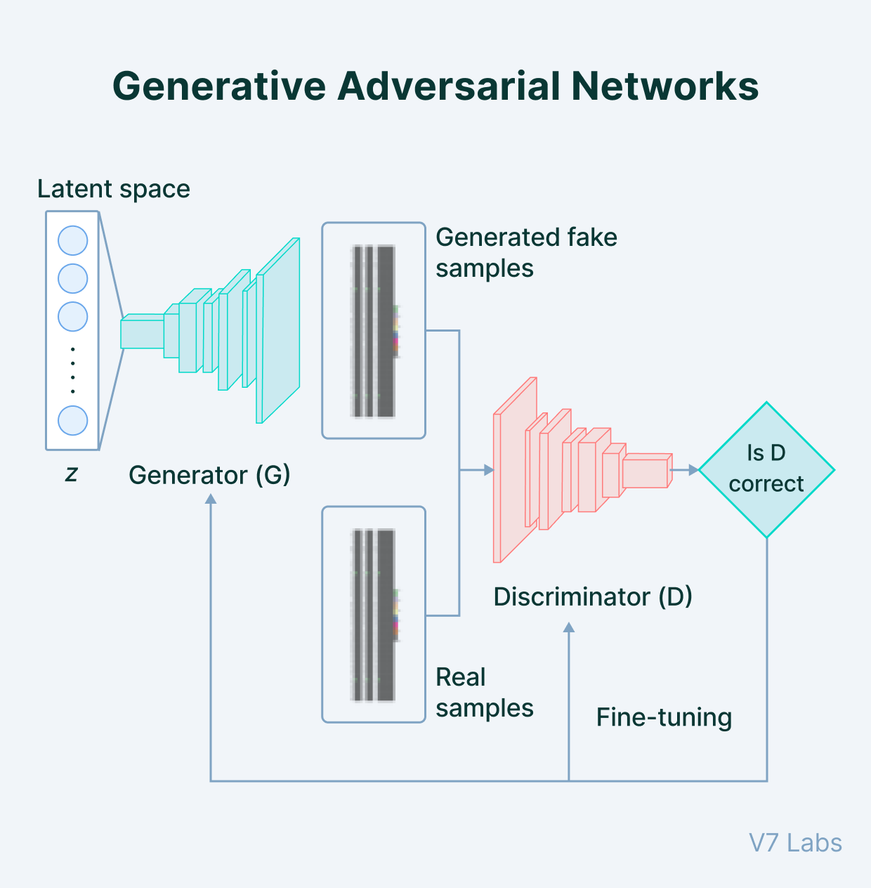

Slide 24
Transformers
Transformers are the new class deep learning model that is used mostly for the tasks related to modeling sequential data, like that in NLP. It is much more powerful than RNNs and they are replacing them in every task.
Recently, transformers are also being applied in computer vision tasks and they are proving to be quite effective than the traditional CNNs.

Slide 25
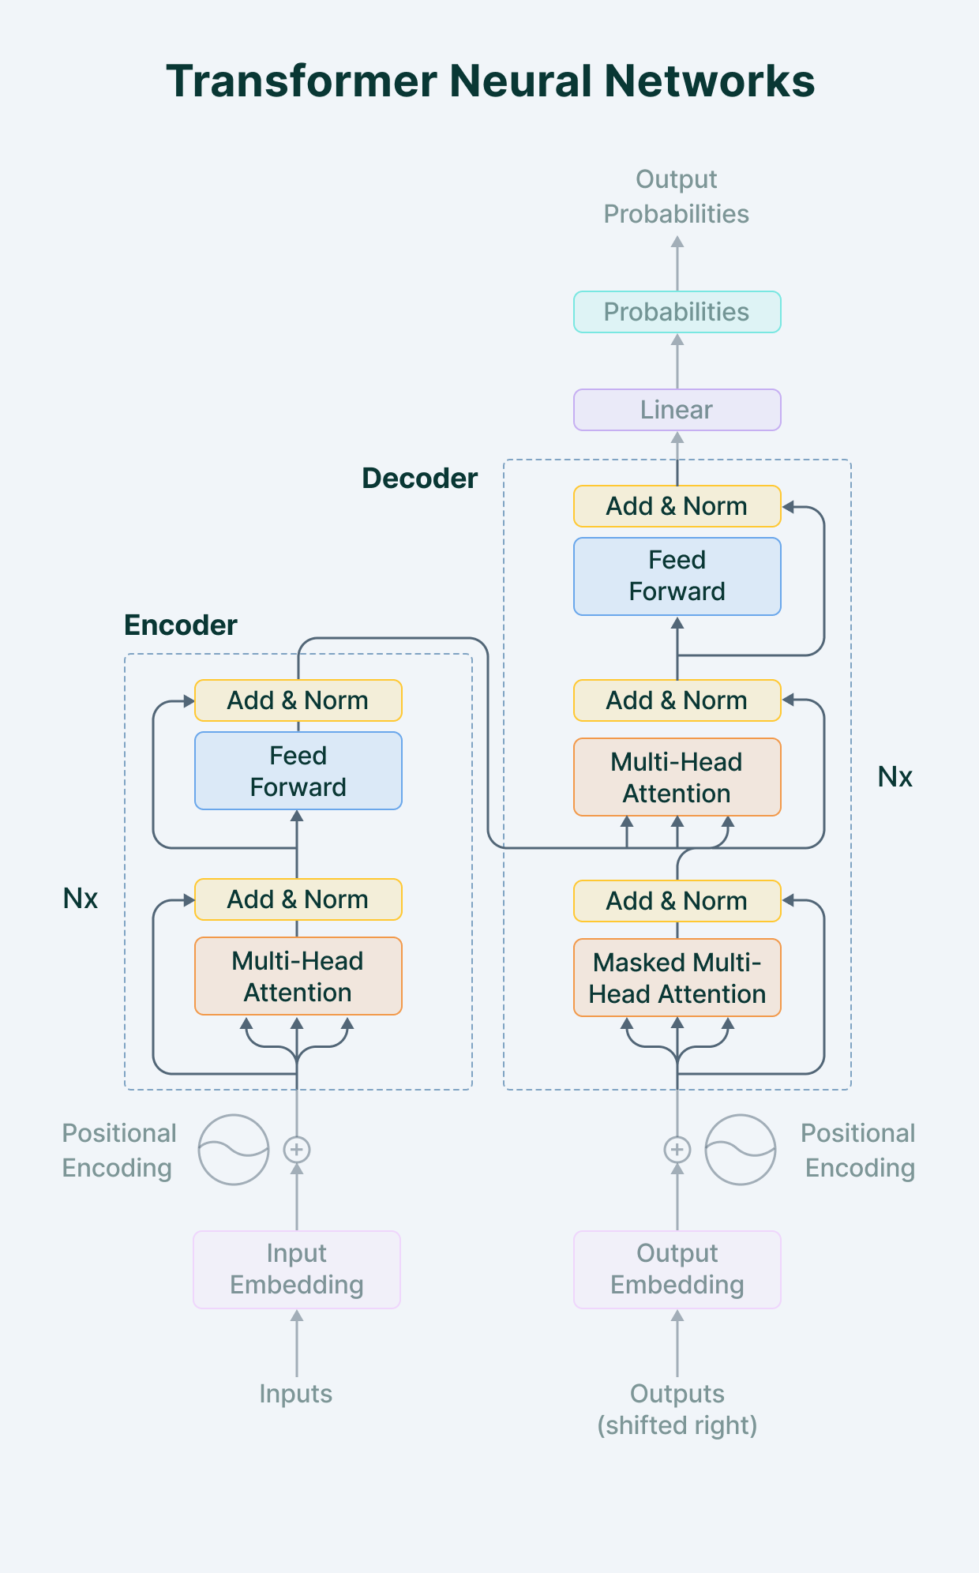

Slide 26
Transformers
The Transformer architecture follows an encoder-decoder structure, but does not rely on recurrence and convolutions in order to generate an output.
the task of the encoder, on the left half of the Transformer architecture, is to map an input sequence to a sequence of continuous representations, which is then fed into a decoder.
The decoder, on the right half of the architecture, receives the output of the encoder together with the decoder output at the previous time step, to generate an output sequence.

Slide 27
Restricted Boltzmann Machine
Restricted Boltzmann Machine is an undirected graphical model that plays a major role in the deep learning framework.
Initially, it was introduced by Paul Smolensky in 1986 as a Harmonium, which then gained huge popularity in recent years in the context of the Netflix Price, where RBM achieved state-of-the-art performance in collaborative filtering and have beaten most of the competition.

Slide 28
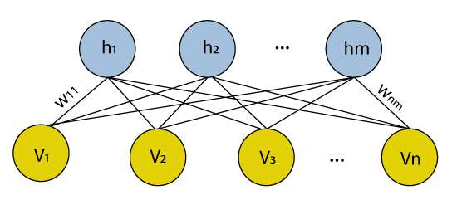
Restricted Boltzmann Machine
Many hidden layers can be efficiently learned by composing restricted Boltzmann machines using the future activations of one as the training data for the next. These are basically the neural network that belongs to so-called energy-based models. It is an algorithm that is used for dimensionality reduction, classification, regression collaborative filtering, feature learning, and topic modeling.

Slide 29
Autoencoders
An autoencoder neural network is another kind of unsupervised machine learning algorithm. Here the number of hidden cells is merely small than that of the input cells. But the number of input cells is equivalent to the number of output cells.
An autoencoder network is trained to display the output similar to the fed input to force AEs to find common patterns and generalize the data.
The autoencoders are mainly used for the smaller representation of the input. It helps in the reconstruction of the original data from compressed data. This algorithm is comparatively simple as it only necessitates the output identical to the input.
Encoder: Convert input data in lower dimensions.
Decoder: Reconstruct the compressed data.

Slide 30
Thank U

